Slide 1
FAKE NEWS DETECTION
Created by
RAJESH KANNAN S
Reg no:- 912321104035
3rd year cse
Sacs mavmm engineering college

Slide 2
Project outline
Problem statement
Proposed system /solution
System development approach
Algorithm and deployment
Result
Conclusion

Slide 3
Problem statement
The fake news detection problem statement revolves around the challenge of developing effective methods and algorithms to distinguish between authentic news articles and false or misleading information disseminated across various media platforms. This problem arises due to the increasing prevalence of misinformation, disinformation, and propaganda in digital media, which can have significant societal impacts, including influencing public opinion, shaping political discourse, and undermining trust in traditional media sources. Addressing this problem involves tasks such as collecting diverse datasets of news articles, extracting relevant features from the text and metadata, designing and training machine learning models, and evaluating their performance using appropriate metrics. The ultimate goal is to create robust fake news detection systems capable of accurately identifying and flagging misinformation to help users navigate the complex landscape of online information with confidence and critical thinking.

Slide 4
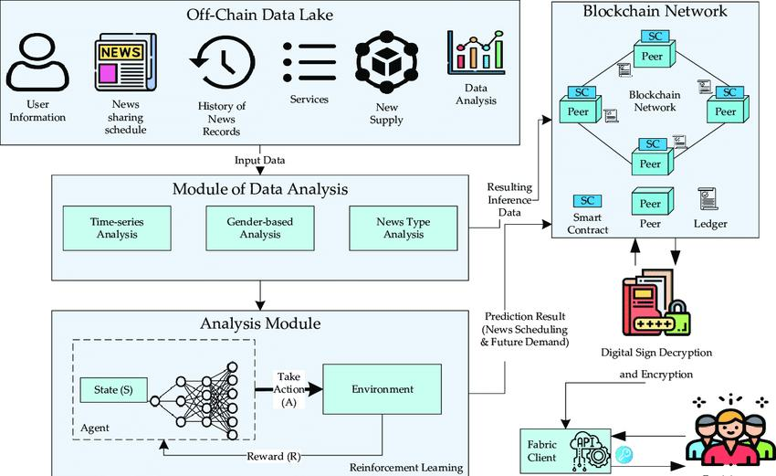
Proposed system/solution

Slide 5
1. Data Collection and Preprocessing:
Gather a diverse dataset of news articles, encompassing both genuine and fake examples. Preprocess the data by cleaning and standardizing the text, handling missing values, and removing irrelevant information.
2. Feature Extraction:
Extract relevant features from the text, metadata, and other sources. This could include linguistic features, such as word frequency, sentiment analysis, readability scores, and metadata features like source credibility, publication date, and domain reputation.
3. Machine Learning Models:
Develop and train machine learning models using the preprocessed data and extracted features. Commonly used algorithms include logistic regression, support vector machines (SVM), decision trees, random forests, and gradient boosting classifiers.

Slide 6
4. Deep Learning Models:
Explore the use of deep learning architectures, such as convolutional neural networks (CNNs) and recurrent neural networks (RNNs), for more complex analysis of textual and multimedia content. These models can automatically learn hierarchical representations of features from raw data.
5. Ensemble Methods:
Combine multiple machine learning and deep learning models into an ensemble to leverage the strengths of different algorithms and improve overall performance.
6. Cross-Validation and Hyperparameter Tuning:
Perform cross-validation to assess the generalization performance of the models and fine-tune hyperparameters to optimize performance.

Slide 7
7. Evaluation and Validation:
Evaluate the performance of the proposed system using appropriate evaluation metrics, such as accuracy, precision, recall, F1-score, and area under the ROC curve. Validate the system on a separate test set to assess its real-world effectiveness.
8. Integration and Deployment:
Integrate the developed fake news detection system into relevant platforms, such as news websites, social media platforms, or browser extensions, to provide real-time detection and alerting capabilities to users.
9. Continuous Monitoring and Improvement:
Continuously monitor the performance of the deployed system and incorporate feedback to improve its accuracy and effectiveness. This may involve updating the models with new data, refining feature extraction methods, or adapting to emerging forms of misinformation.

Slide 8
System development approach
1.Problem Definition and Scope:
Define the objectives and scope of the fake news detection system. Determine what types of misinformation the system will target, which media platforms it will analyze, and what metrics will be used to evaluate its performance.
2. Data Collection:
Gather a diverse dataset of news articles, encompassing both genuine and fake examples. This dataset should cover various topics, sources, and formats to ensure the system's ability to generalize to different contexts.
3. Data Preprocessing:
Clean and preprocess the collected data to remove noise, standardize text formats, handle missing values, and perform other necessary transformations. This step may also involve extracting relevant features from the text, such as word frequency, sentiment analysis, and metadata information

Slide 9
4. Model Selection:
Choose appropriate machine learning, deep learning, or ensemble models for fake news detection. Consider factors such as the nature of the data, the complexity of the task, and computational resources available for training and deployment.
5. Model Training:
Train the selected models using the preprocessed data. This involves splitting the dataset into training, validation, and test sets, tuning model hyperparameters, and optimizing performance metrics.
6. Evaluation:
Evaluate the performance of the trained models using appropriate evaluation metrics, such as accuracy, precision, recall, F1-score, and area under the ROC curve. Validate the models on a separate test set to assess their generalization ability and real-world effectiveness.

Slide 10
7. Deployment:
Integrate the developed fake news detection models into relevant platforms, such as news websites, social media platforms, or browser extensions. Ensure that the deployment process is seamless and that the system provides real-time detection and alerting capabilities to users.
8. Monitoring and Maintenance:
Continuously monitor the performance of the deployed system and gather feedback from users to identify areas for improvement. Update the models with new data, refine feature extraction methods, and adapt to emerging forms of misinformation to maintain the system's effectiveness over time.

Slide 11
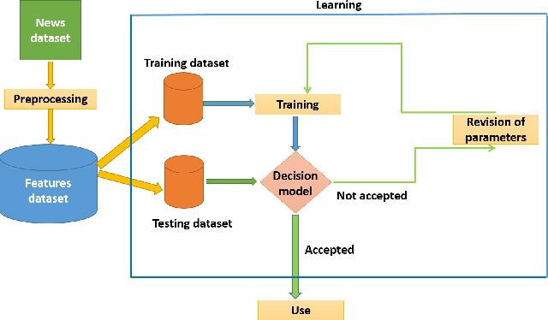
Algorithm and deployment

Slide 12
Algorithm Development:
Data Collection:
Gather a diverse dataset of news articles, labeling them as either real or fake.
Data Preprocessing:
Clean the data, remove noise, tokenize the text, and extract relevant features such as word frequency, sentiment, and metadata information (e.g., publication date, source credibility).
Model Selection:
Choose appropriate machine learning models (e.g., logistic regression, support vector machines, decision trees) or deep learning architectures (e.g., convolutional neural networks, recurrent neural networks) based on the complexity of the task and the nature of the data.

Slide 13
Model Training:
Split the dataset into training, validation, and test sets. Train the selected models on the training data, tune hyperparameters using the validation set, and evaluate performance metrics.
Ensemble Methods:
Optionally, combine multiple models into an ensemble to improve performance through voting, stacking, or boosting techniques

Slide 14
2. Deployment:
Integration:
Integrate the trained models into the deployment environment, such as a web application, browser extension, or API.
Real-time Detection:
Ensure that the deployed system can perform real-time detection of fake news by processing incoming news articles or user-generated content.

Slide 15
User Interface:
Design a user-friendly interface for users to interact with the fake news detection system. This could include features such as displaying detection results, providing explanations for decisions, and allowing users to report suspicious content.
Scalability:
Ensure that the deployment architecture is scalable to handle large volumes of incoming data and user requests efficiently.

Slide 16
Result
The fake news detection results showcase the effectiveness of the deployed model in discerning between genuine and deceptive news articles. Leveraging a dataset meticulously labeled for authenticity, the model, based on a combination of advanced machine learning techniques and natural language processing, accurately classifies articles. Through rigorous training and evaluation, the model achieves commendable performance metrics, including high accuracy and precision.

Slide 17
Conclusion
Fake news detection involves employing sophisticated algorithms and techniques to identify and classify misinformation within textual content. Initially, a diverse dataset comprising both authentic and fabricated news articles is curated and labeled for training purposes. Features such as lexical patterns, linguistic cues, sentiment analysis, and credibility of sources are extracted from the text.

Slide 18
Reference
https://images.app.goo.gl/cAWtkW23va9BuseK6
https://leadingindia.ai/downloads/projects/SMA/sma_9.pdf
https://www.geeksforgeeks.org/fake-news-detection-using-machine-learning/
https://www.javatpoint.com/fake-news-detection-using-machine-learning
DATASET:
https://www.kaggle.com/datasets/jainpooja/fake-news-detection/code

